Slide 1
Introduction and applications of Machine learning
组长：黄琪2050041
组员：2253156闫浩扬 2151219王传臻 2251784 殷文宇
2253747黄量 2253765 杨羽晞 2252754张毓晨

Slide 2
Basic theory

Slide 3
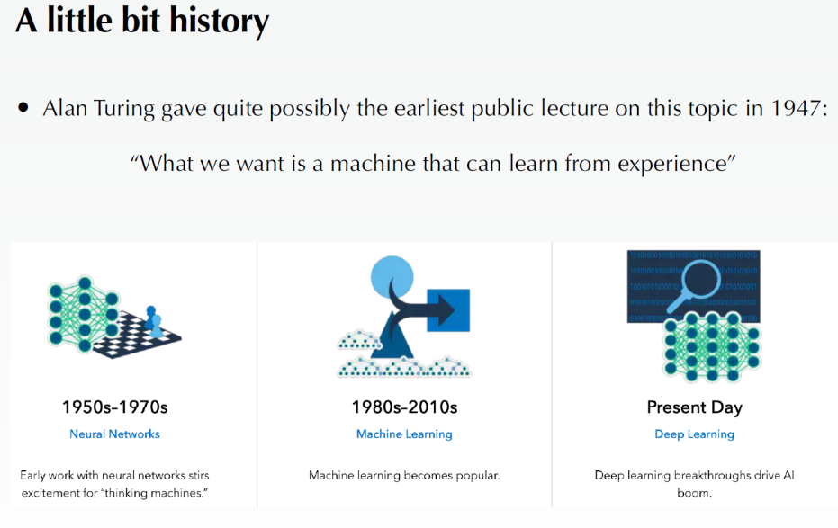

Slide 4
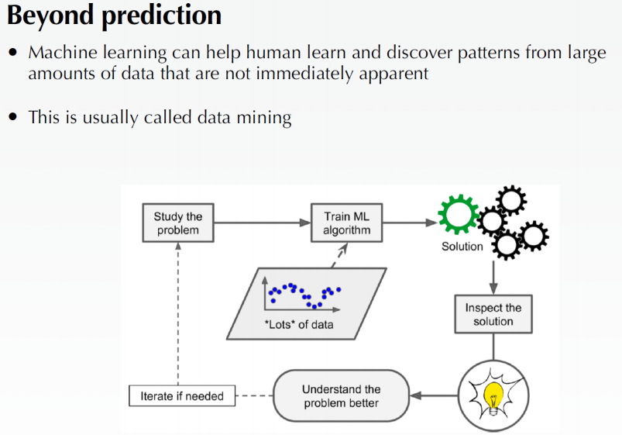

Slide 5
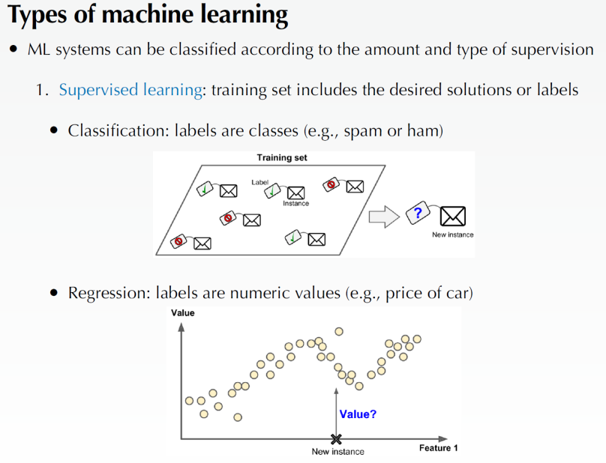

Slide 6
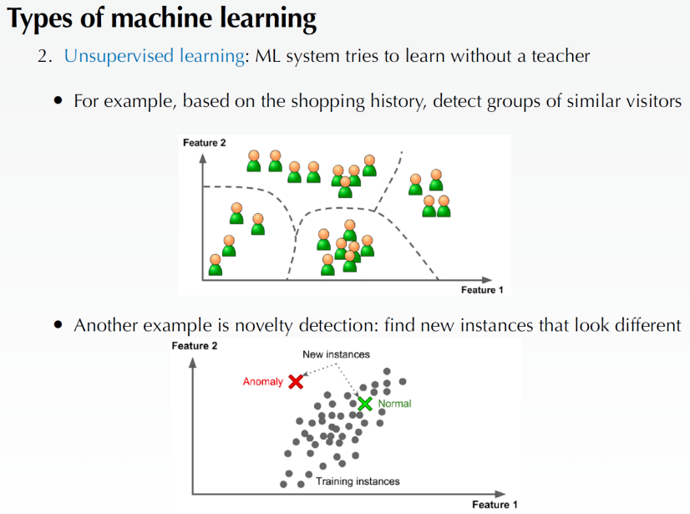

Slide 7
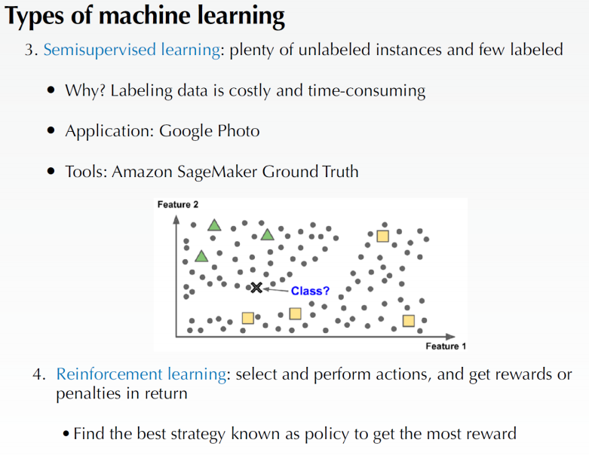

Slide 8
Decision Trees, Random Forests &Ensemble Learning

Slide 9
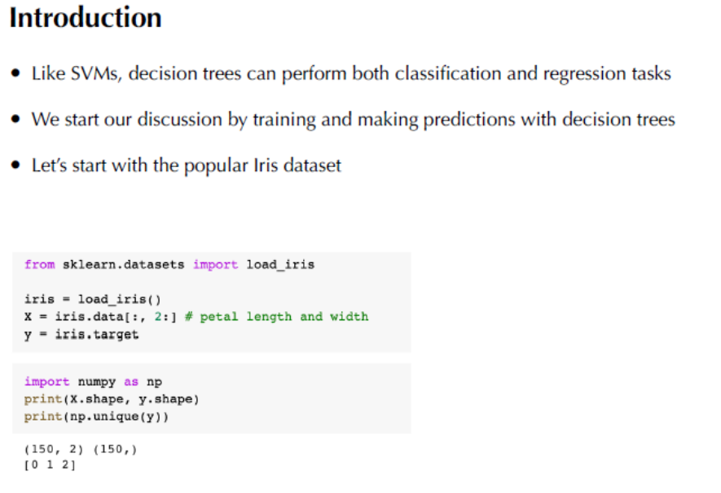

Slide 10
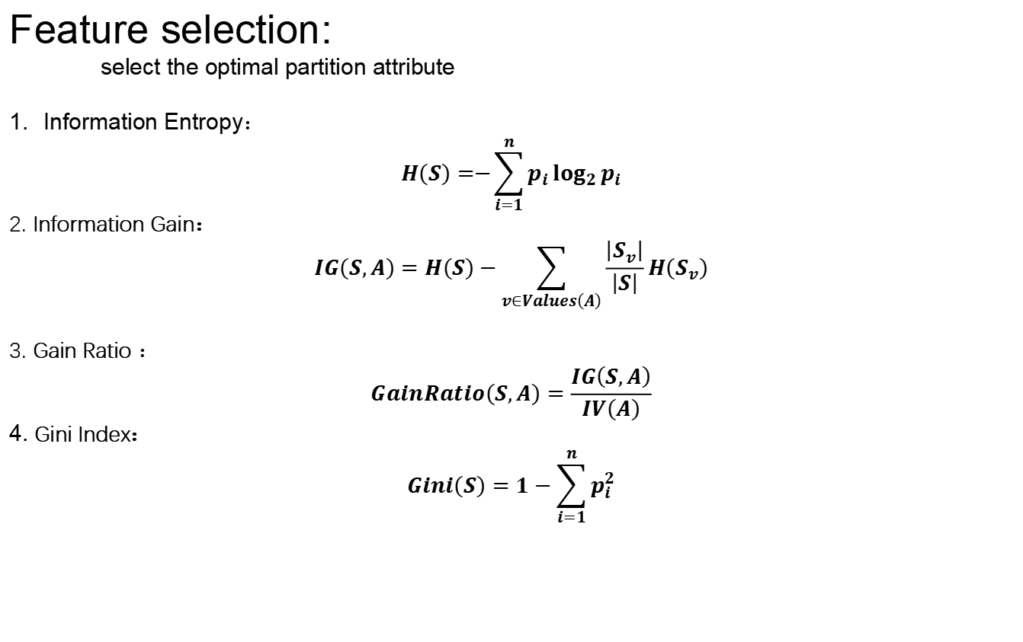
Feature selection:
select the optimal partition attribute
Information Entropy：
$$H\left(S\right)=−{\sum_{i=1}^{n}{p_{i}}log}_{2}{p_{i}}$$
2. Information Gain：
$$IG\left(S,A\right)=H\left(S\right)−\sum_{v∈Values\left(A\right)}{\frac{\left|S_{v}\right|}{\left|S\right|}}H\left(S_{v}\right)$$
3. Gain Ratio ：
$$GainRatio\left(S,A\right)=\frac{IG\left(S,A\right)}{IV\left(A\right)}$$
4. Gini Index：
$$Gini\left(S\right)=1−\sum_{i=1}^{n}{p_{i}^{2}}$$

Slide 11
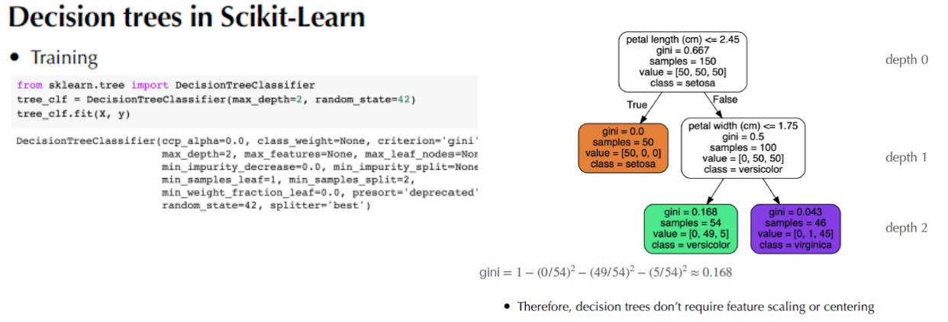

Slide 12
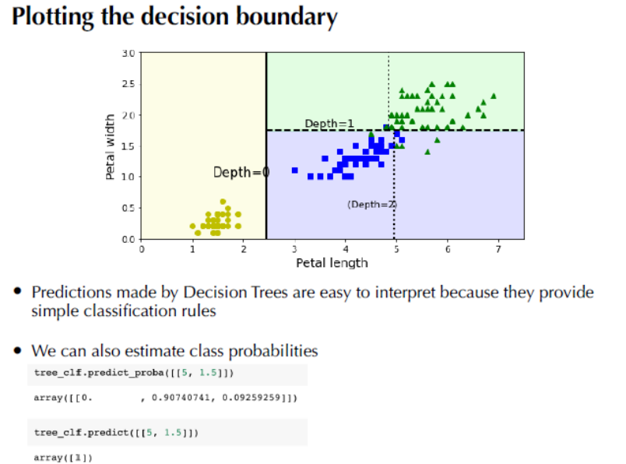

Slide 13
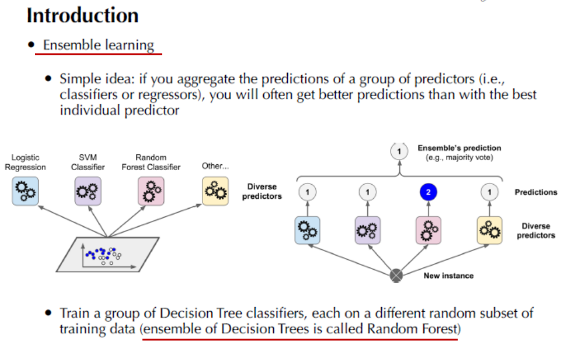

Slide 14
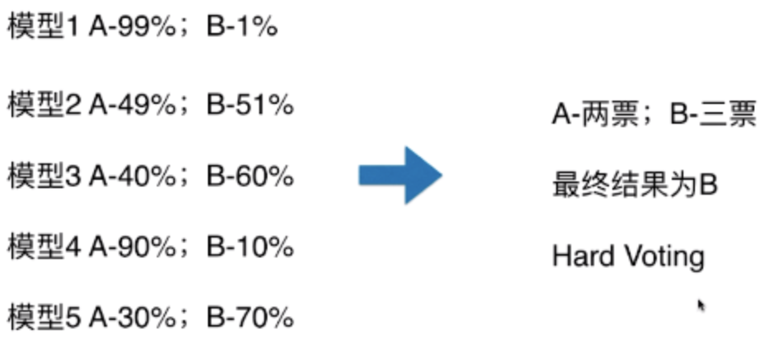
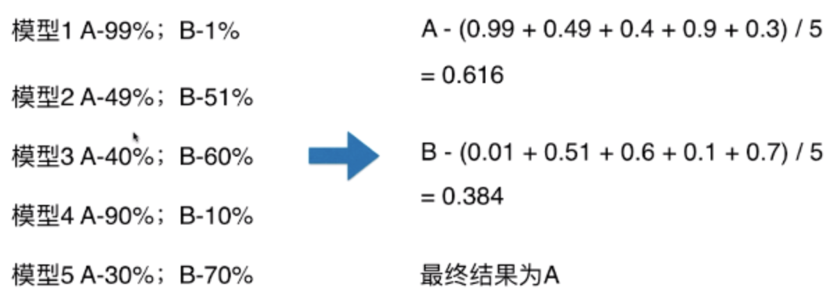
Voting classifier
an ensemble learning voting mechanism that integrates different algorithms to predict the same problem .
1.Hard Voting Classifier: The final result is determined by the principle of the minority being subordinate to the majority;
2.Soft Voting Classifier: The average of the probabilities predicted by all models for the sample to be a certain category is taken as the standard. The category corresponding to the highest probability is the final prediction result.

Slide 15
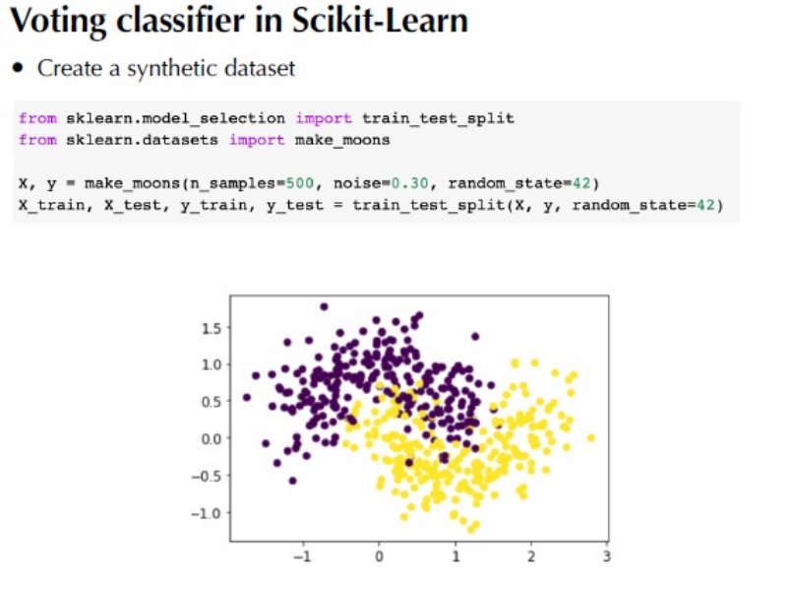

Slide 16
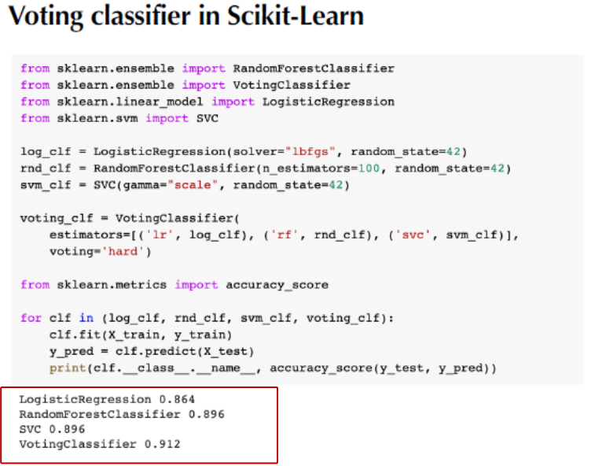

Slide 17
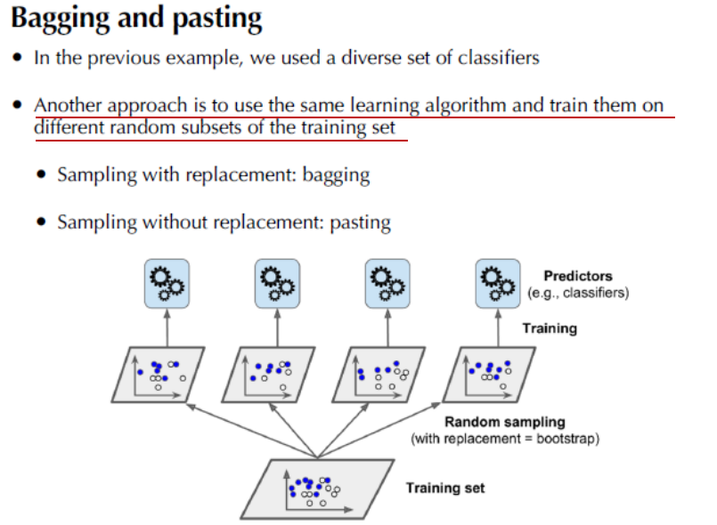

Slide 18
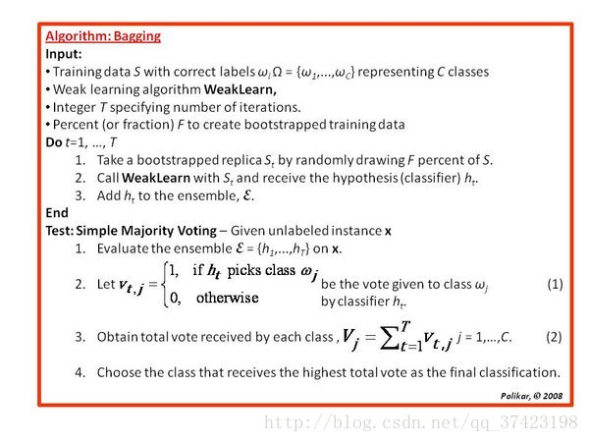

Slide 19
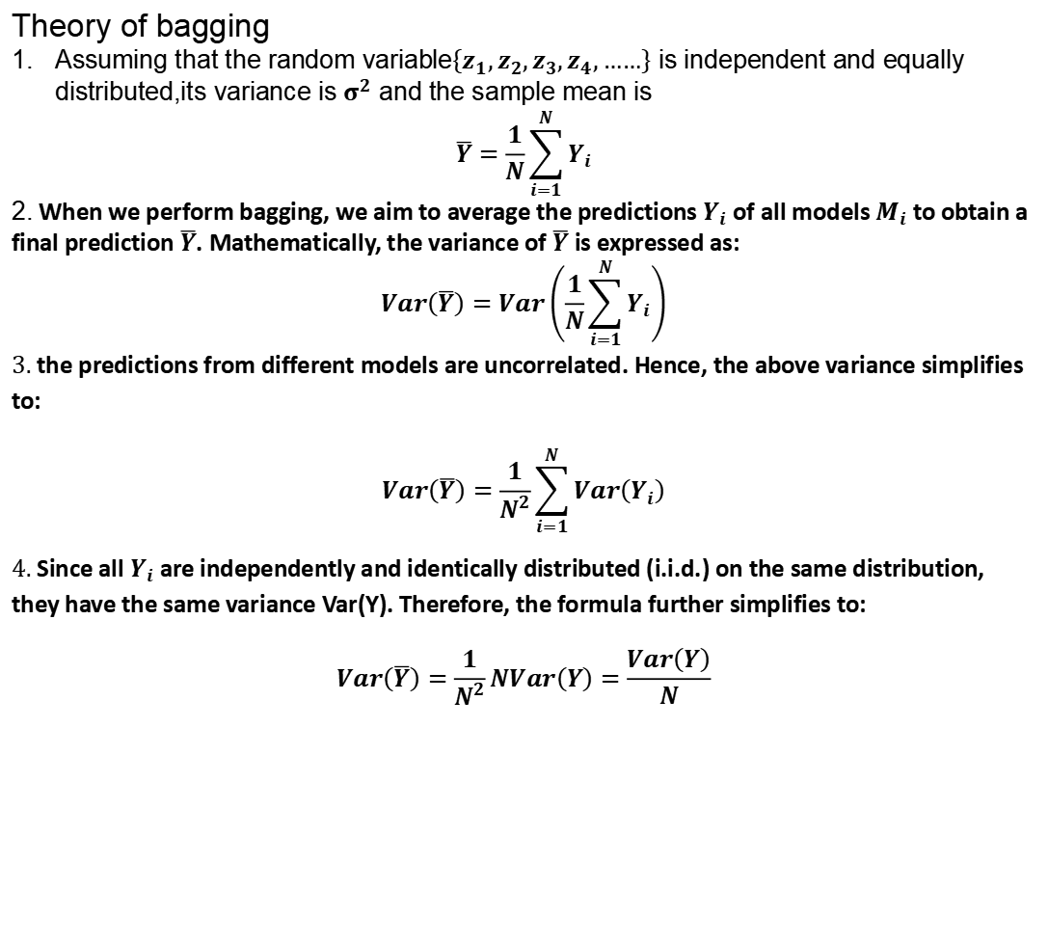
Theory of bagging
Assuming that the random variable$\left\{z_{1},z_{2},z_{3},z_{4},……\right\}$ is independent and equally distributed,its variance is $σ^{2}$ and the sample mean is
$$\overline{Y}=\frac{1}{N}\sum_{i=1}^{N}{Y_{i}}$$
2. When we perform bagging, we aim to average the predictions $Y_{i}$ of all models $M_{i}$ to obtain a final prediction $\overline{Y}$. Mathematically, the variance of $\overline{Y}$ is expressed as:
$$Var\left(\overline{Y}\right)=Var\left(\frac{1}{N}\sum_{i=1}^{N}{Y_{i}}\right)$$
3. the predictions from different models are uncorrelated. Hence, the above variance simplifies to:
$$Var\left(\overline{Y}\right)=\frac{1}{N^{2}}\sum_{i=1}^{N}{Var\left(Y_{i}\right)}$$
4. Since all $Y_{i}$ are independently and identically distributed (i.i.d.) on the same distribution, they have the same variance Var(Y). Therefore, the formula further simplifies to:
$$Var\left(\overline{Y}\right)=\frac{1}{N^{2}}NVar\left(Y\right)=\frac{Var\left(Y\right)}{N}$$

Slide 20
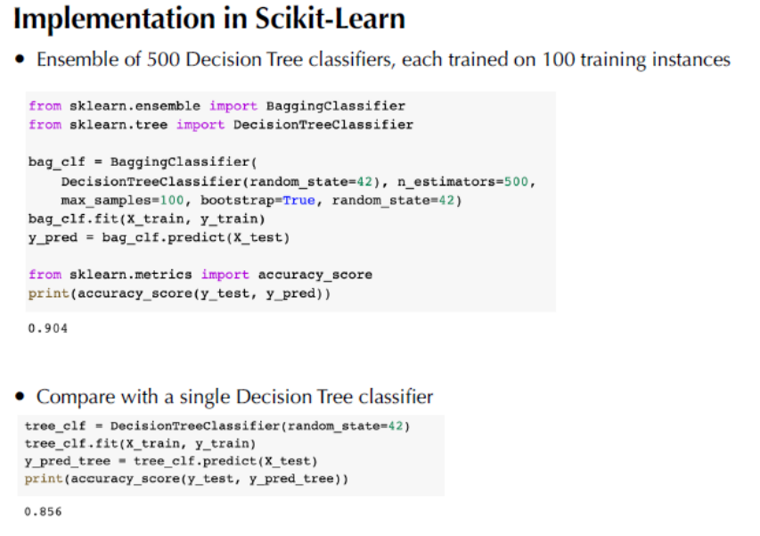

Slide 21
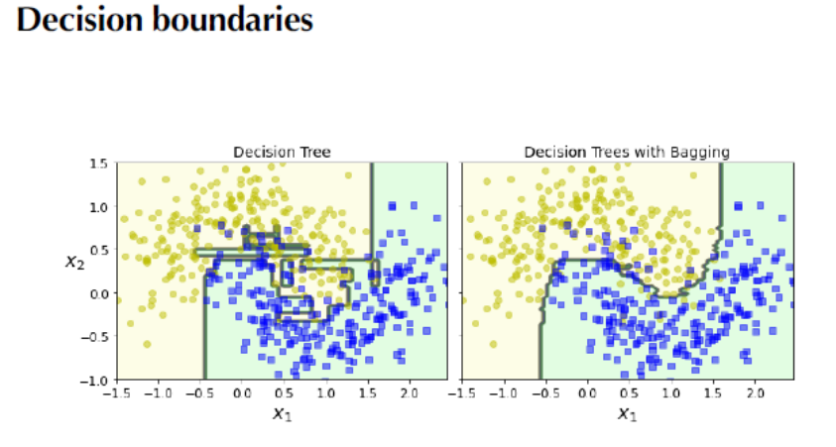

Slide 22
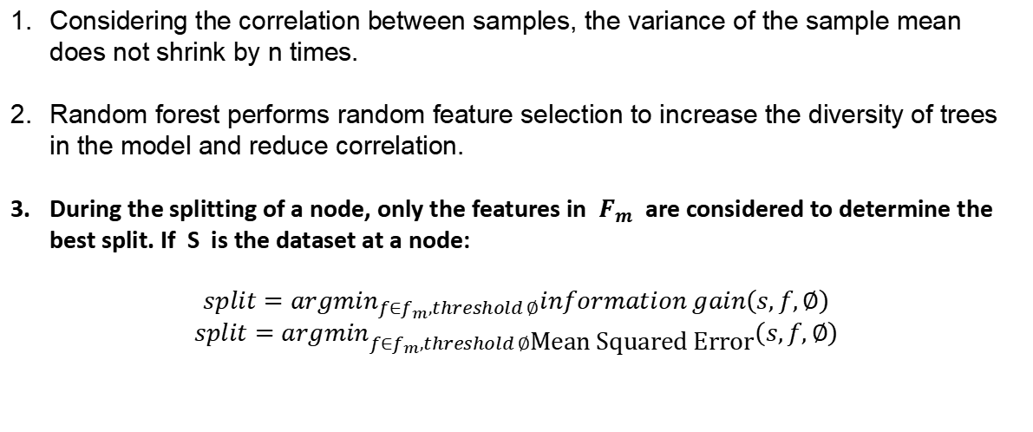
Random forest
Considering the correlation between samples, the variance of the sample mean does not shrink by n times.
Random forest performs random feature selection to increase the diversity of trees in the model and reduce correlation.
During the splitting of a node, only the features in $F_{m}$ are considered to determine the best split. If S is the dataset at a node:
$$split=argmin_{f∈f_{m},threshold ∅}information gain\left(s,f,∅\right)$$
$$split=argmin_{f∈f_{m},threshold ∅\text{Mean} \text{Squared} \text{Error}}\left(s,f,∅\right)$$

Slide 23
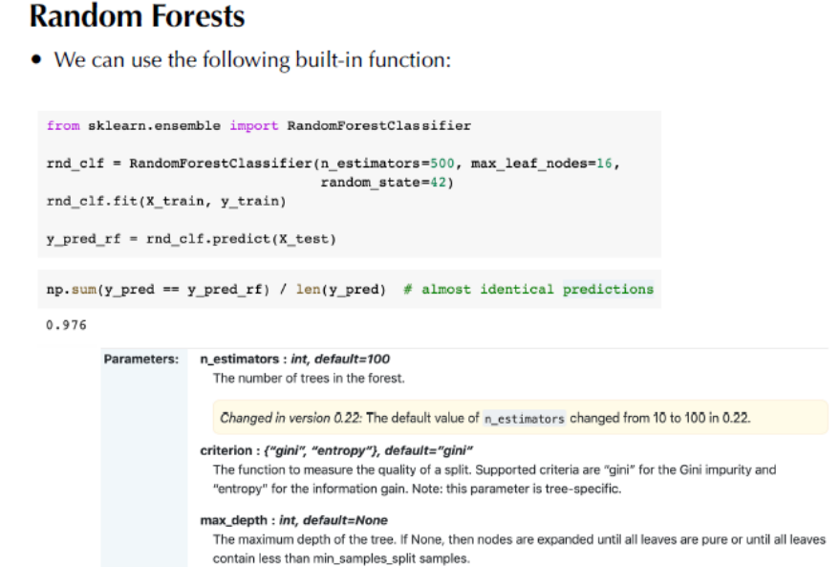

Slide 24
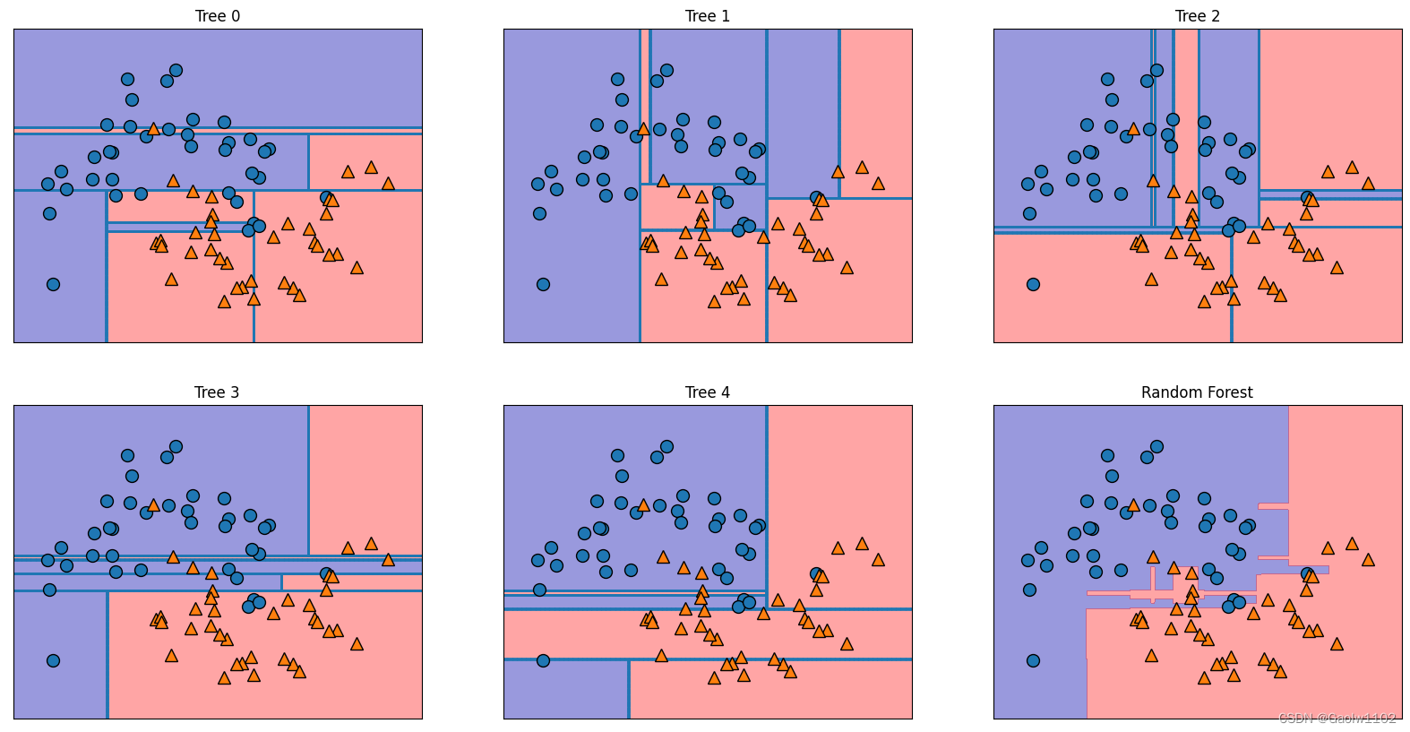

Slide 25
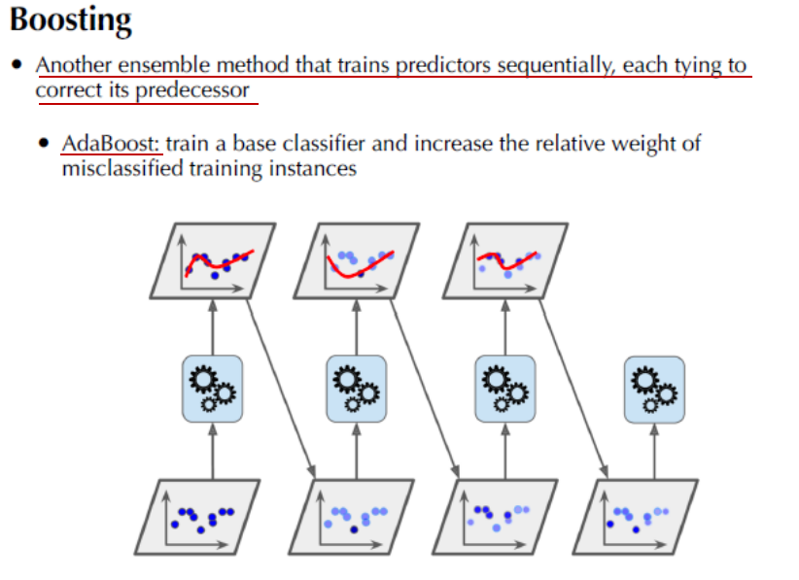

Slide 26
Convolutional Neural Networks (CNN)

Slide 27
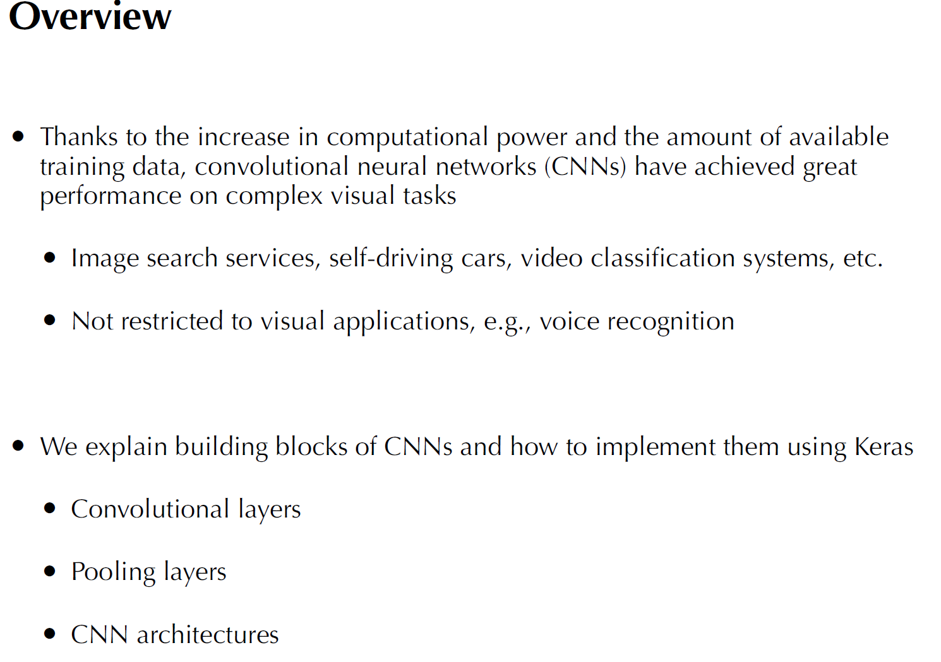

Slide 28
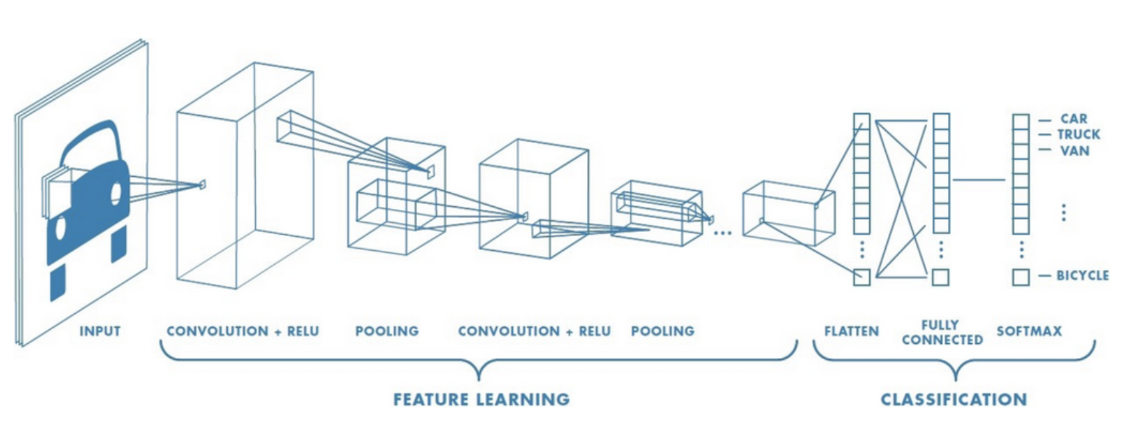
Convolutional neural network
a multi-layer neural network
input-to-output mappings

Slide 29
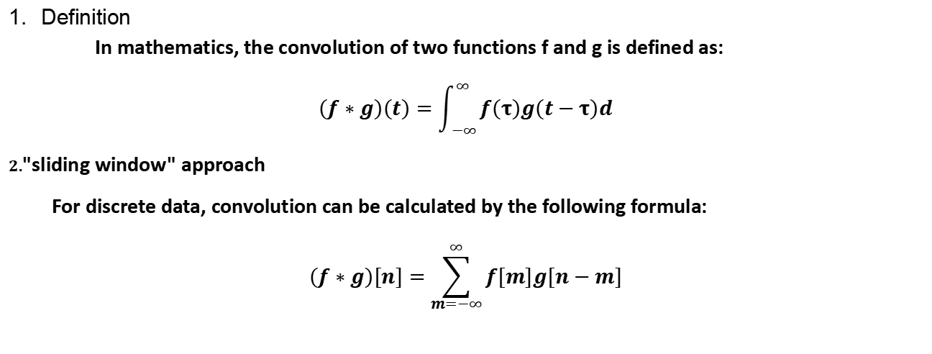
Convolutional
Definition
In mathematics, the convolution of two functions f and g is defined as:
$$\left(f∗g\right)\left(t\right)=\int_{−∞}^{∞}{f\left(τ\right)g\left(t−τ\right)d}$$
2."sliding window" approach
For discrete data, convolution can be calculated by the following formula:
$$\left(f∗g\right)\left[n\right]=\sum_{m=−∞}^{∞}{f\left[m\right]g\left[n−m\right]}$$

Slide 30
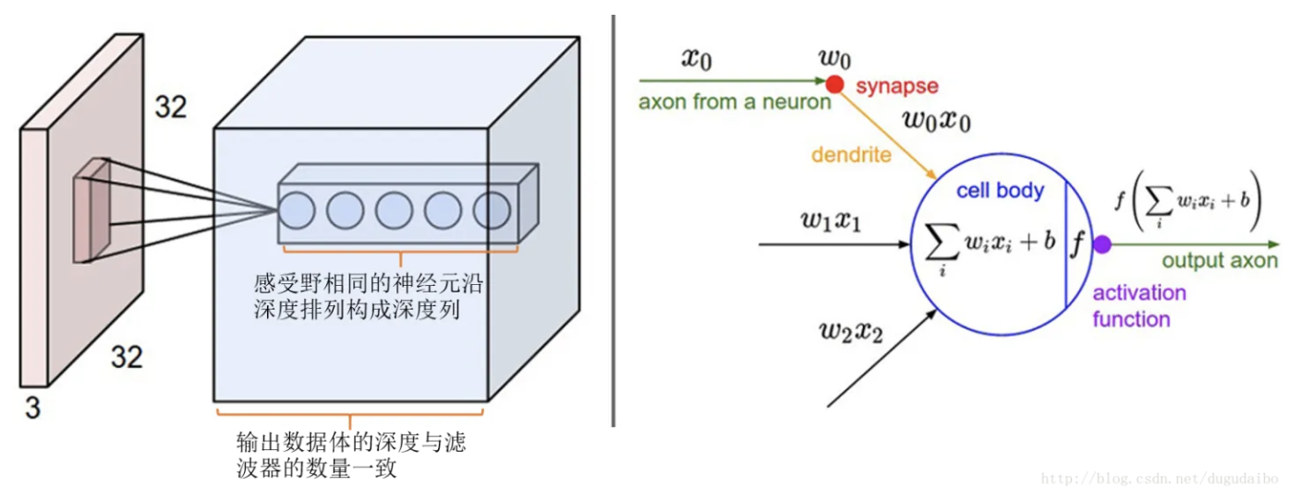
Receptive field
Inputs ($x_{i}$) --> Weights ($w_{i}$) -->
Weighted Sum ($\sum{w_{i}}∗x_{i}$) + Bias (b) -->
Activation Function (f) --> Output

Slide 31
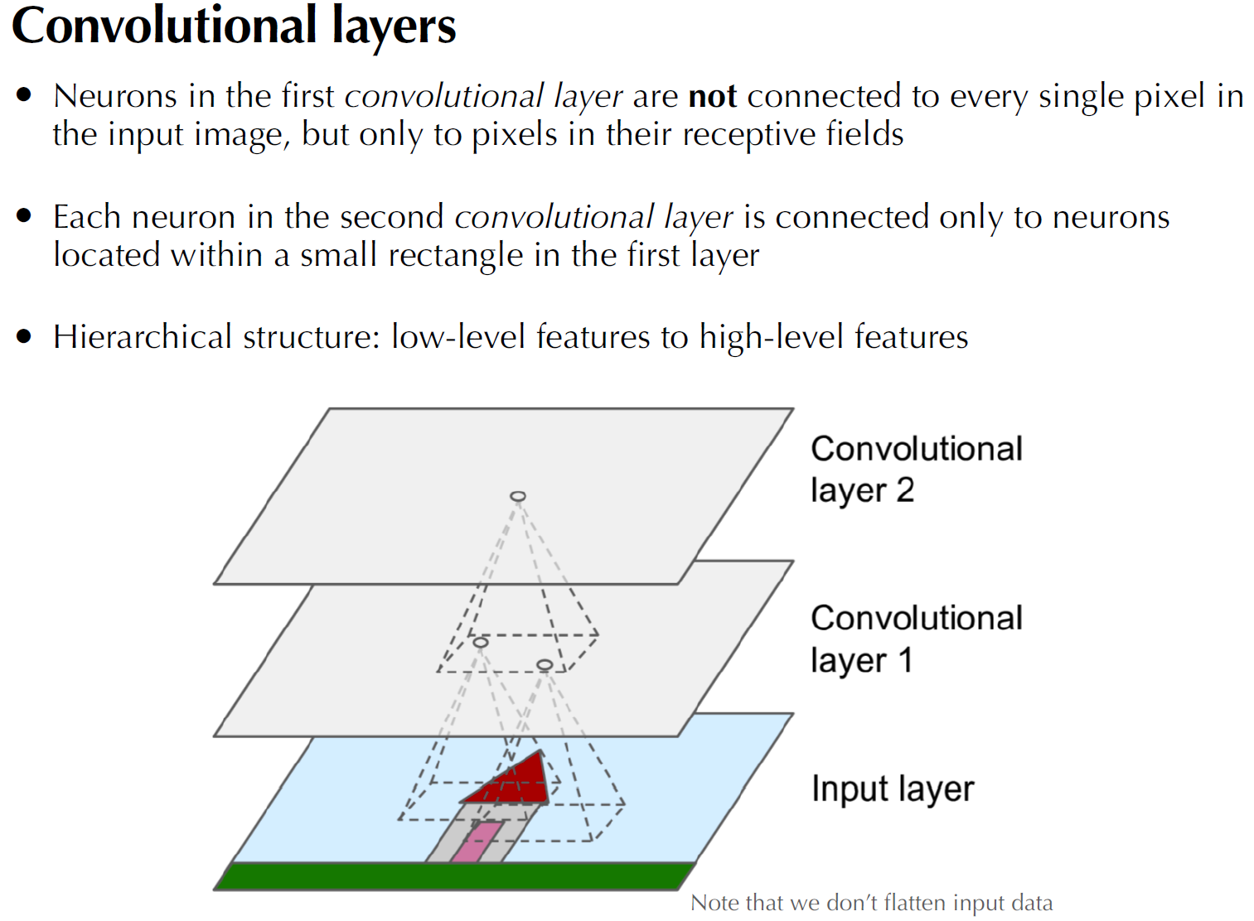

Slide 32
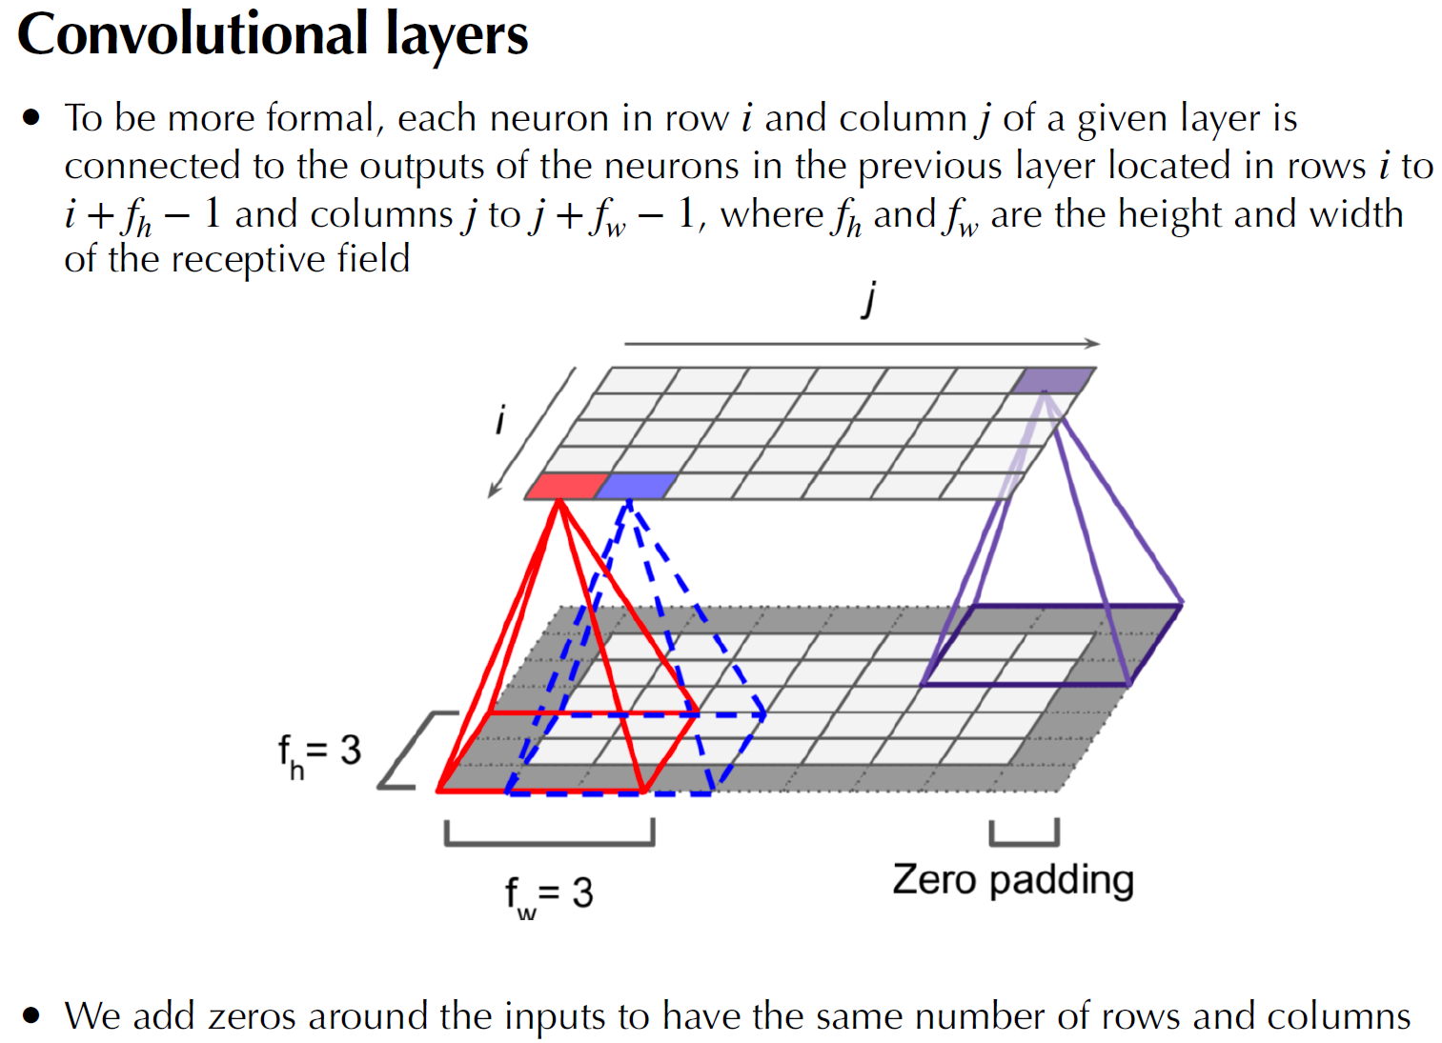

Slide 33
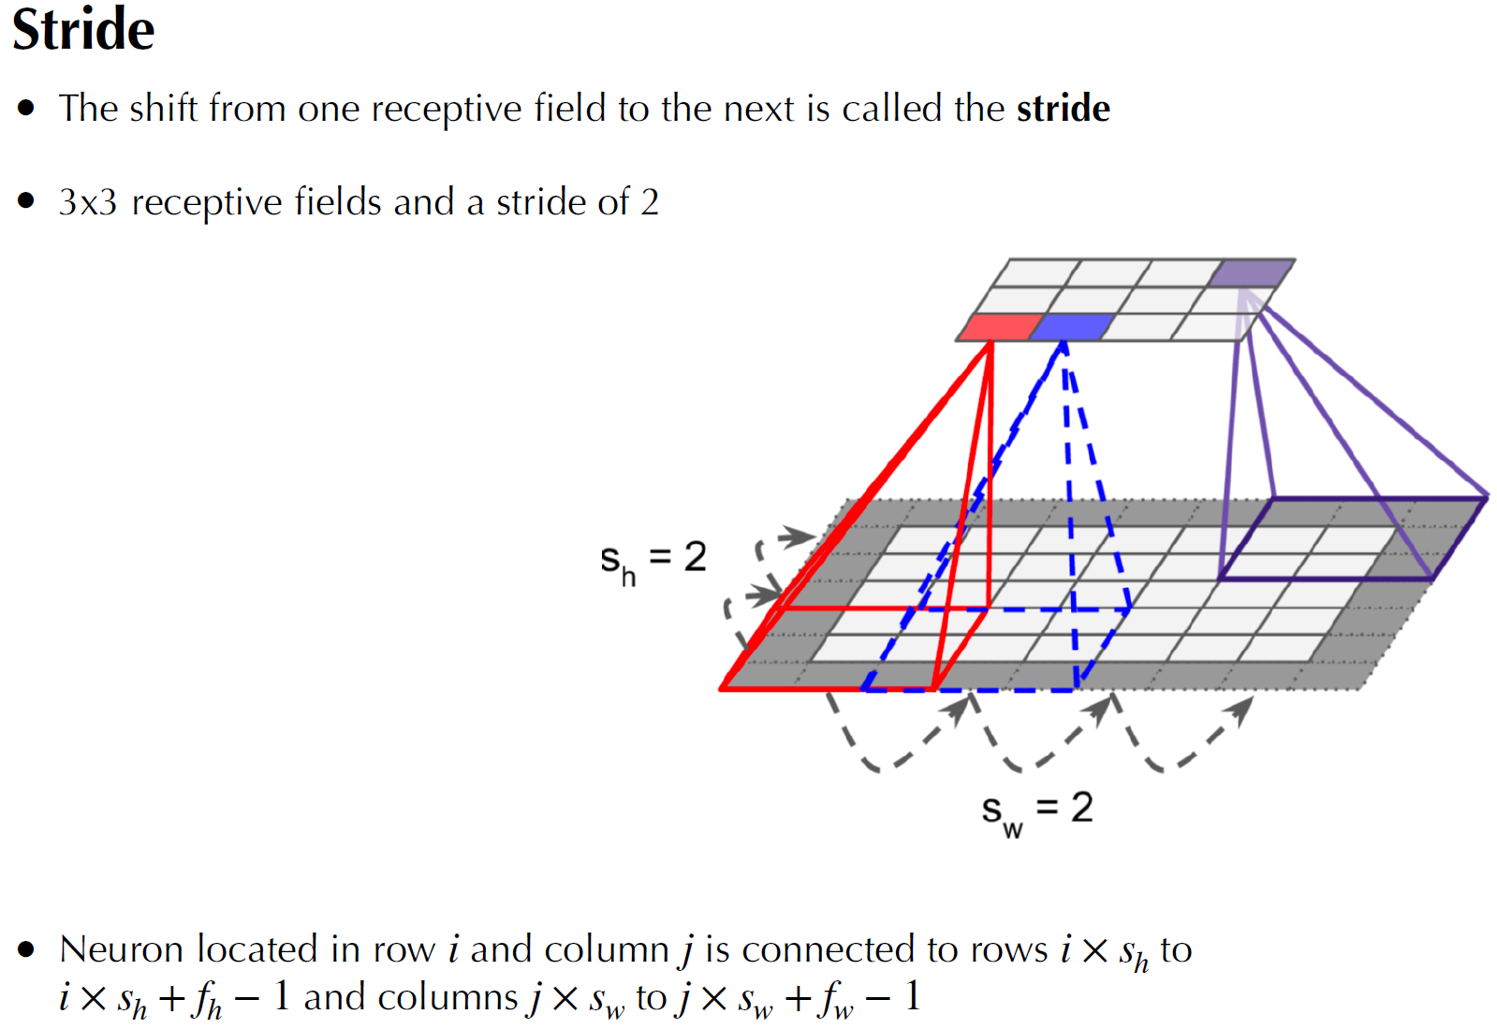

Slide 34
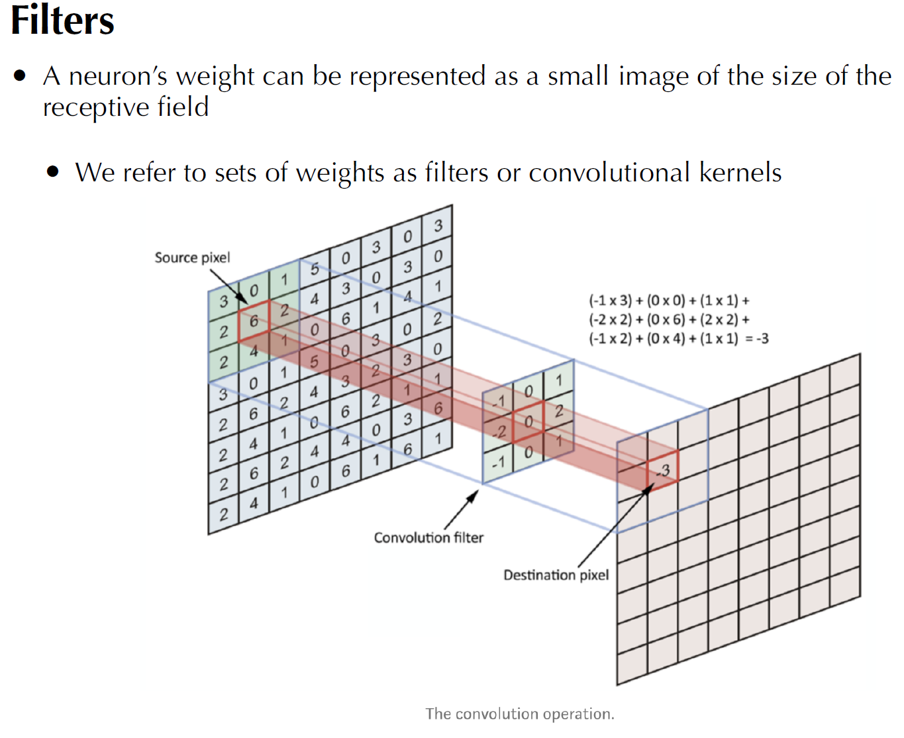

Slide 35
Identity Filter：Hold the picture
Edge Detection Filter：
：highlight the horizontal
emphasizes the difference in intensity of the center pixel
Sharpen Filter：Enhance edges and details in images
Box Blur Filter (normalized):smooth the image.
Gaussian Blur Filter (approximation):Use weight is a smoothing method for approximations of Gaussian functions

Slide 36
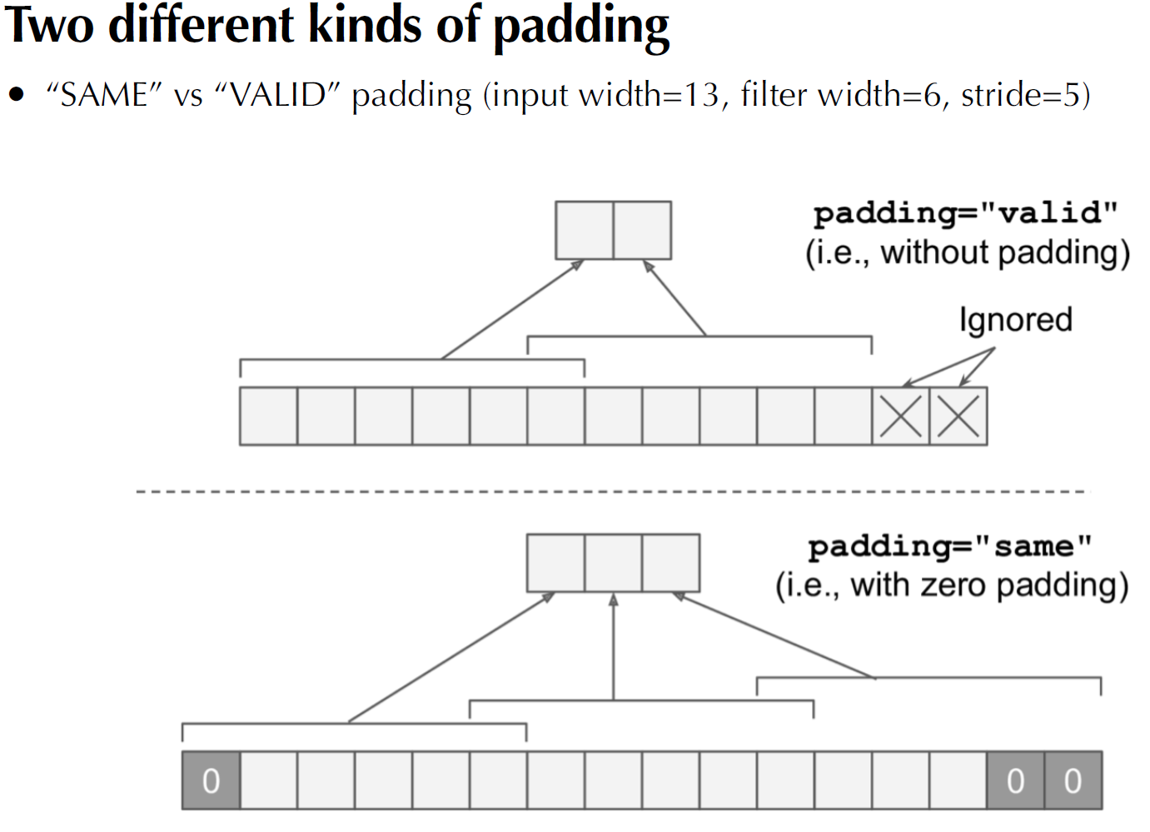

Slide 37
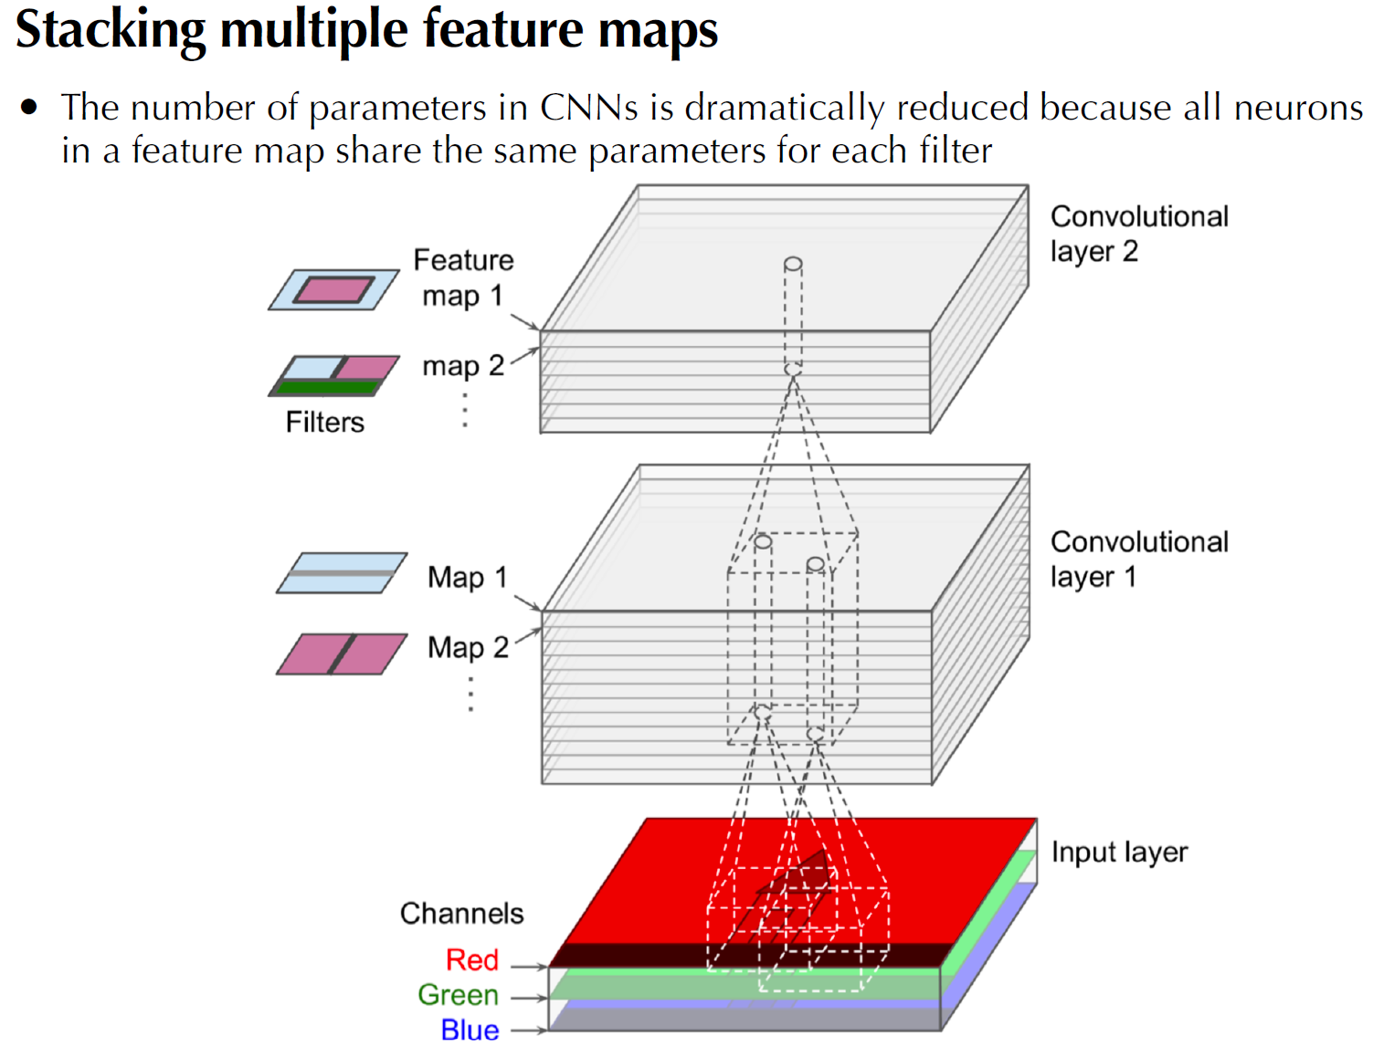

Slide 38
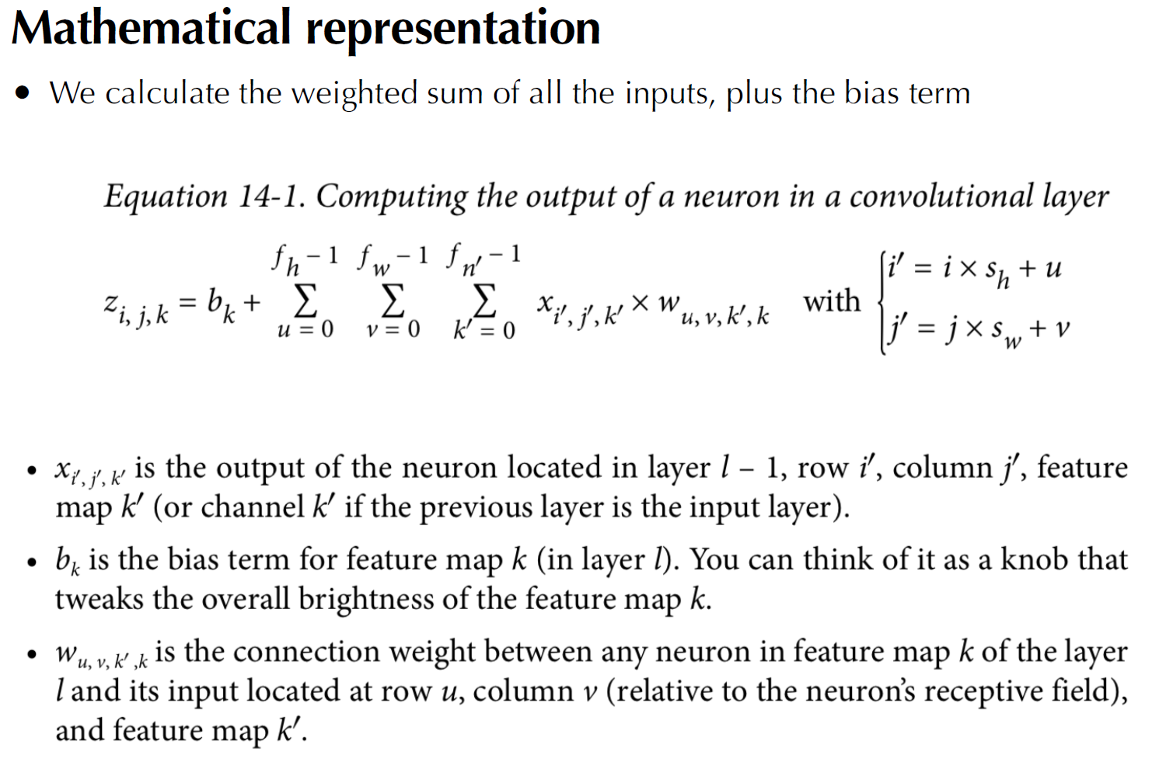

Slide 40
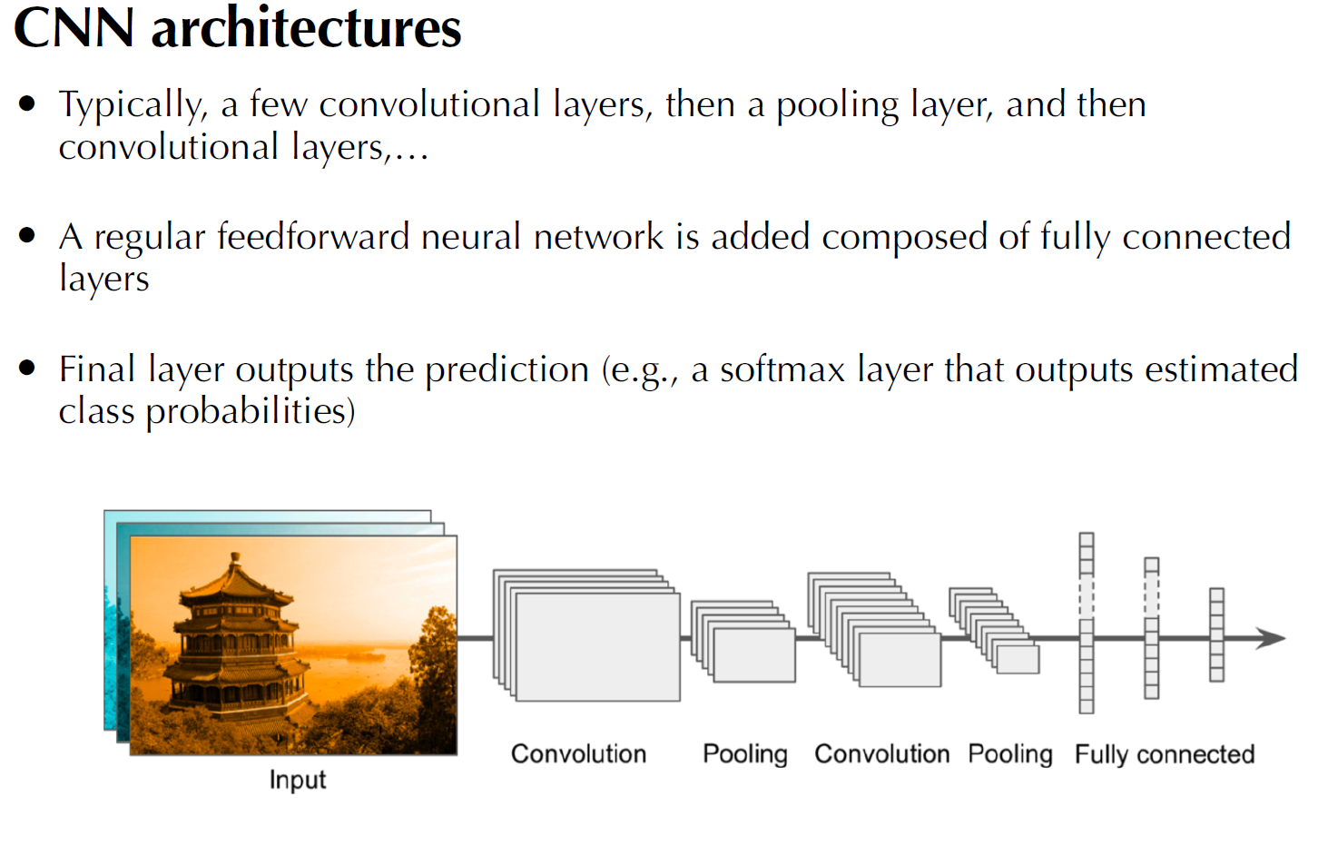

Slide 41
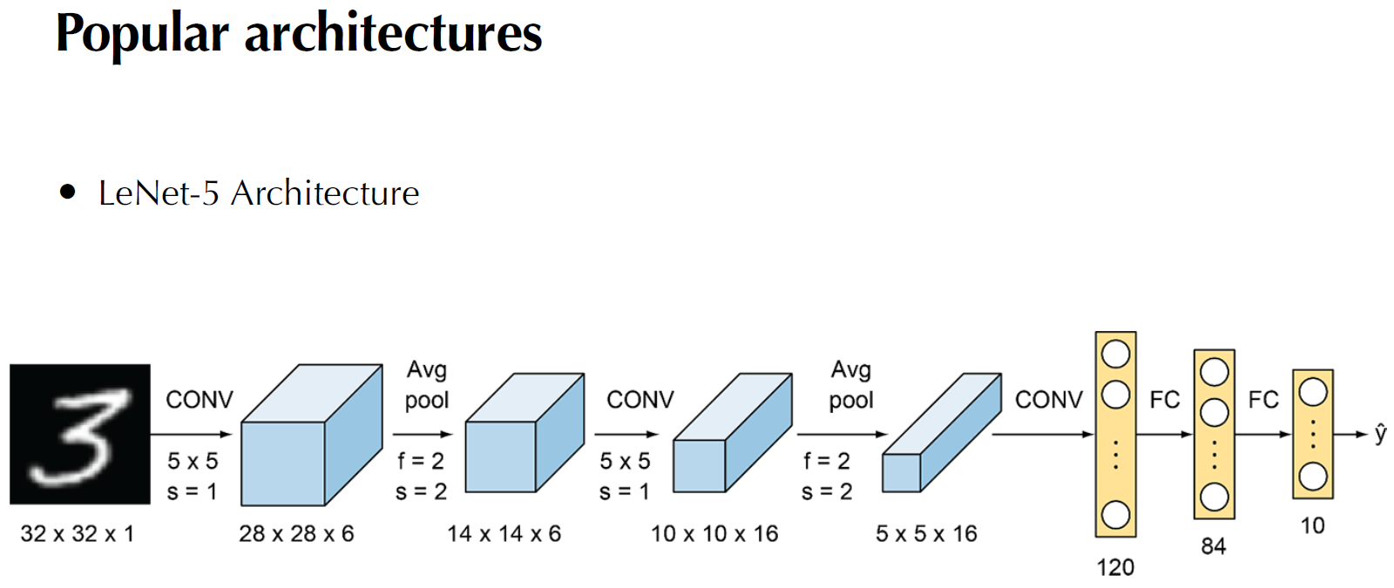

Slide 42
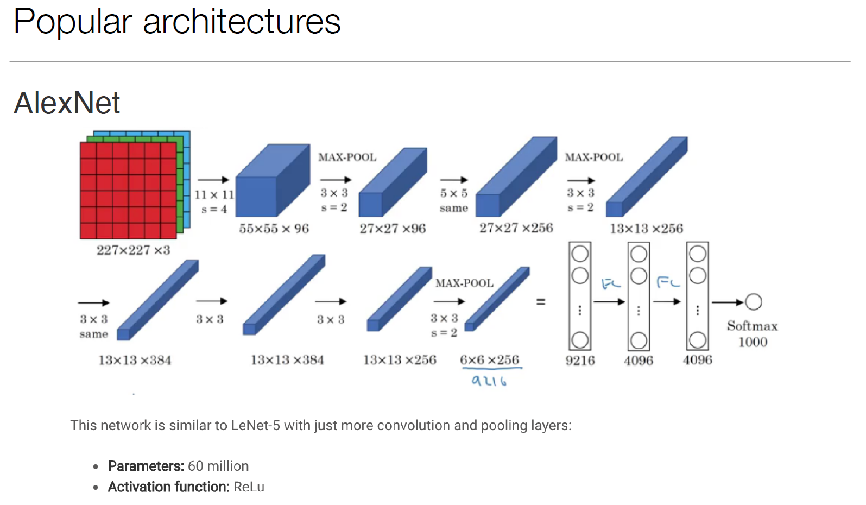

Slide 43
Machine Learning and
Volume-Price CTA
CTA: Commodity Trading Advisor(商品交易顾问)

Slide 44
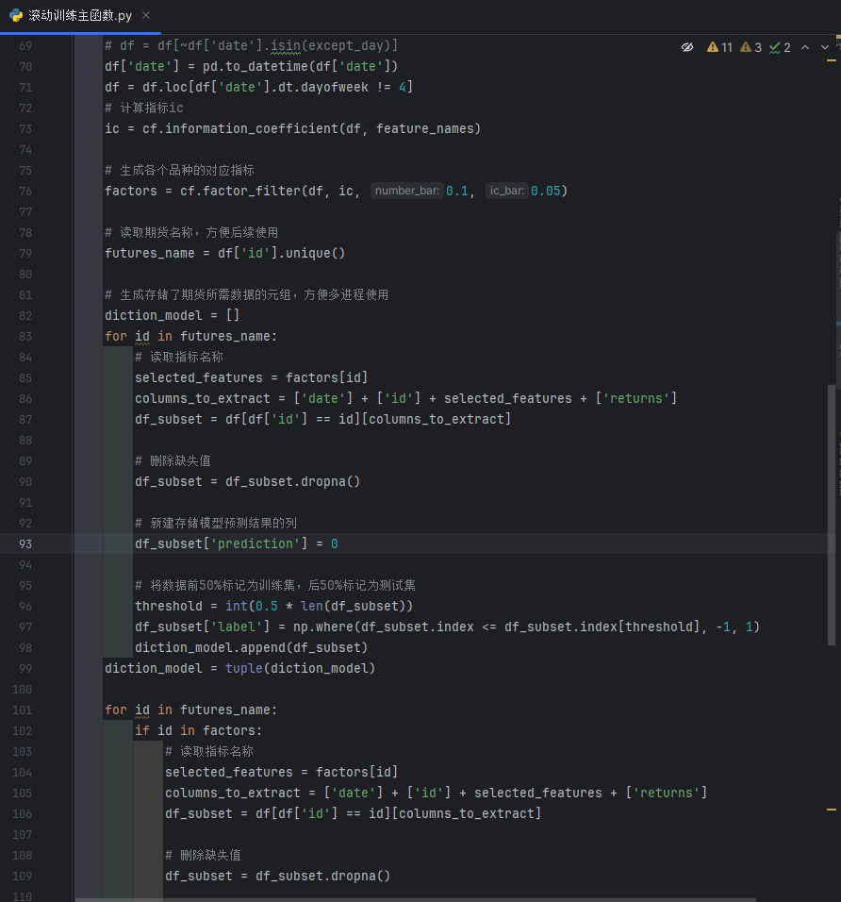
Model Approach
Based on the daily volume and price data of futures, this approach involves generating features that describe the market. Then, an appropriate machine learning model is selected and its hyperparameters are adjusted. The model is trained using the generated features as independent variables and the next day's return rate as the dependent variable. The trained model, along with today's data, is used to predict the return rate for the next day. Based on this prediction, specific opening and closing positions are executed.

Slide 45
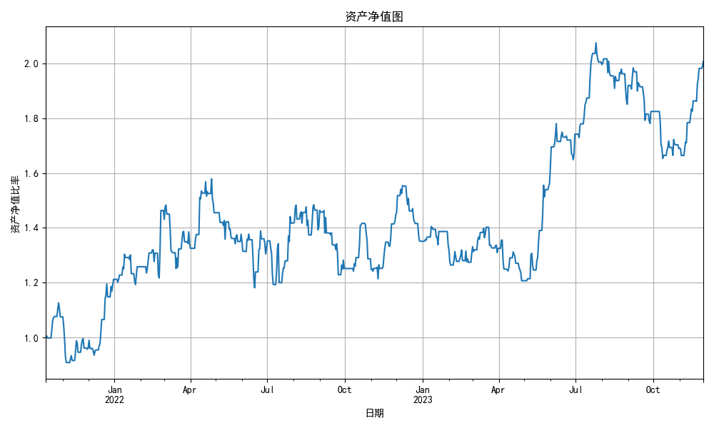
Decision Tree
Number of Trades: 13312 Win Rate: 50.55% Daily Win Rate: 51.80%
Profit/Loss Ratio: 0.996 Daily Profit/Loss Ratio: 1.104 Average Profit/Loss per Trade: 302.473
Maximum Drawdown: 0.252 Total Return Rate: 100.66% Annualized Return Rate: 38.68%
Sharpe Ratio: 1.185 Calmar Ratio: 1.536 Profit/Loss per Hundred Trades: 0.0091781564303699

Slide 46
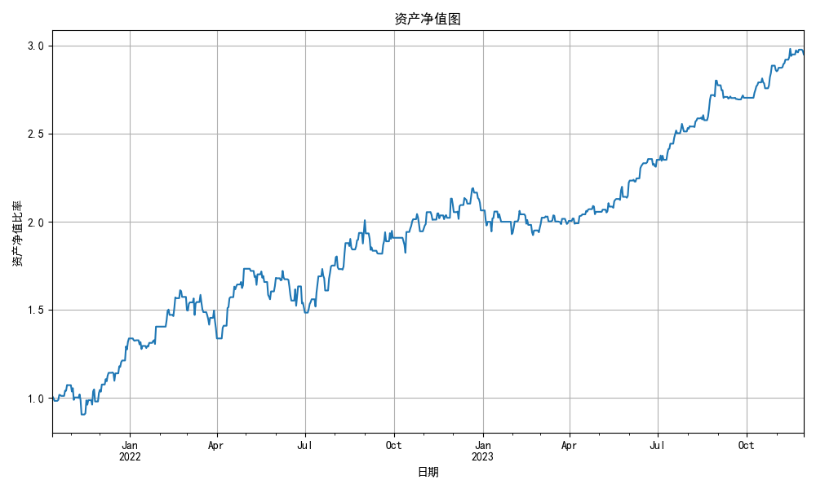
Random Forest
Number of Trades: 6631
Win Rate: 52.54%
Daily Win Rate: 57.21%
Profit/Loss Ratio: 1.009
Daily Profit/Loss Ratio: 1.074
Average Profit/Loss per Trade: 1175.079
Maximum Drawdown: 0.170
Total Return Rate: 194.80%
Annualized Return Rate: 66.23%
Sharpe Ratio: 2.605
Calmar Ratio: 3.903
Profit/Loss per Hundred Trades: 0.05567146822682534

Slide 47
Deep Learning and Text Sentiment Analysis

Slide 48
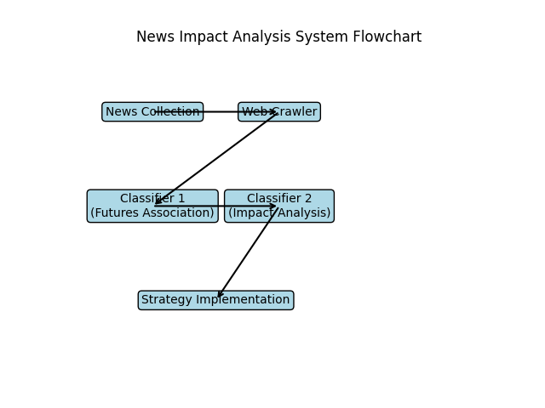
Utilize neural networks for natural language processing to train a model that has the following capabilities: 1. Use scripts to scrape the latest news from major mainstream news websites. 2. Use Classifier 1 to determine which futures commodity the news is related to (or if it's unrelated). 3. Use Classifier 2 to determine whether the news will have a positive, negative, or neutral impact on the price of that futures commodity. 4. Based on the analysis, implement targeted long or short positions.

Slide 49
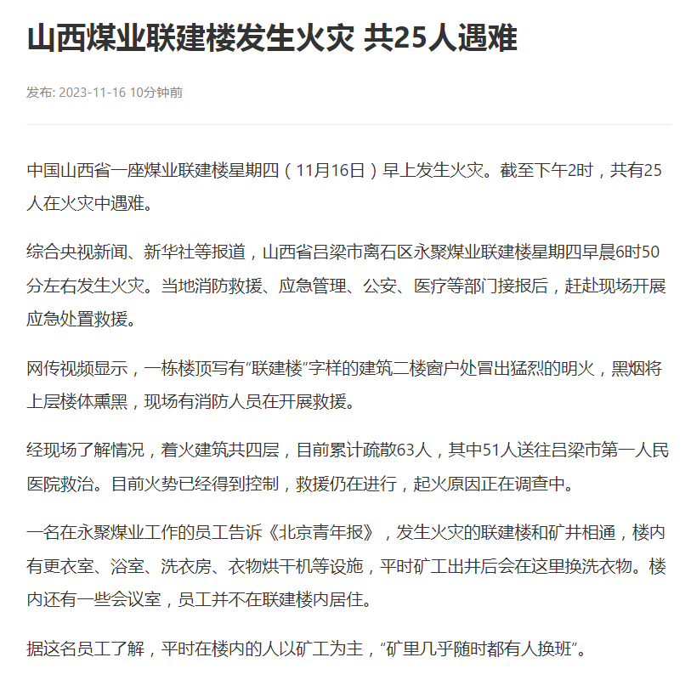
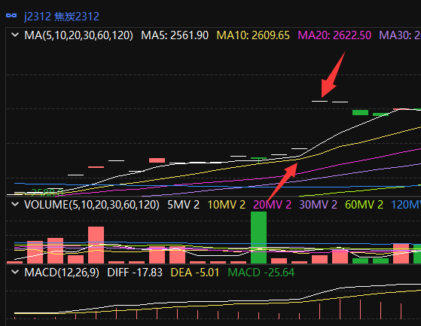
On the morning of November 16, 2023, an accident occurred in a coal mine in Shanxi (due to the accident, production might decrease, leading to a price increase based on supply and demand dynamics). Reports about the incident started to emerge around noon. However, such reports often get buried under a plethora of news, and only a few traders manage to capture this information. At the opening of the market at 1:30 PM that day, the futures of coking coal indeed saw a significant price surge. Traders using artificial intelligence technology to monitor market information in real-time thus took the initiative and reaped substantial profits.

Slide 50
Computer Vision | CV

Slide 51
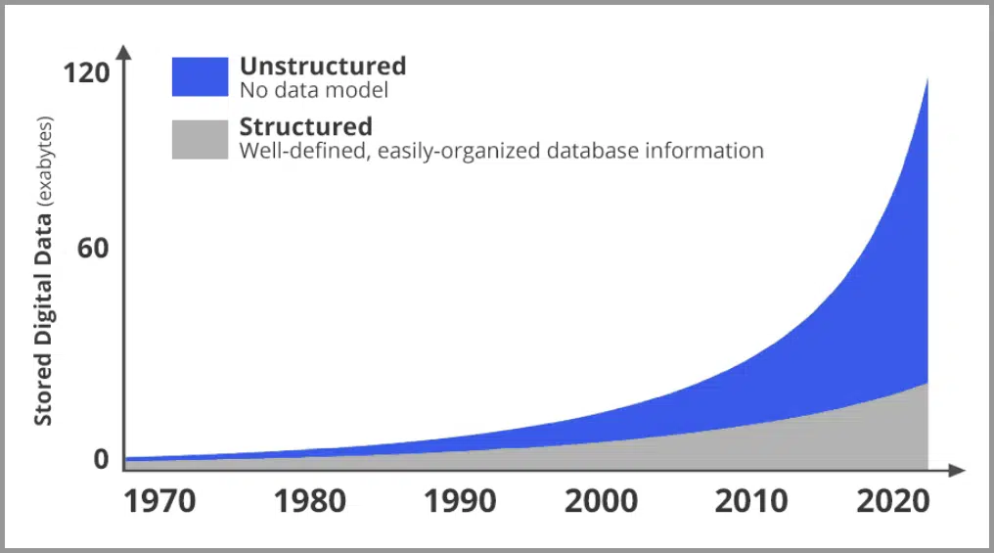
https://easyai.tech/wp-content/uploads/2022/08/846a6-2020-03-05-increase.png.webp
Computer Vision是人工智能领域的一个重要分支。
人的大脑皮层， 有大约70% 都是在处理视觉信息， 是人类获取信息最主要的渠道。
在网络世界，照片和视频（图像的集合）也正在发生爆炸式的增长！计算机视觉在当今有着极其重要的地位。

Slide 52
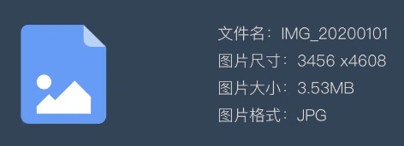
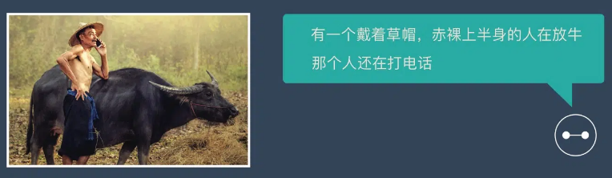
https://easyai.tech/wp-content/uploads/2022/08/846a6-2020-03-05-increase.png.webp
CV之前，计算机只能看到文件属性，看不懂图片内容
CV的出现使得计算机可以“看懂”图片内容

Slide 53
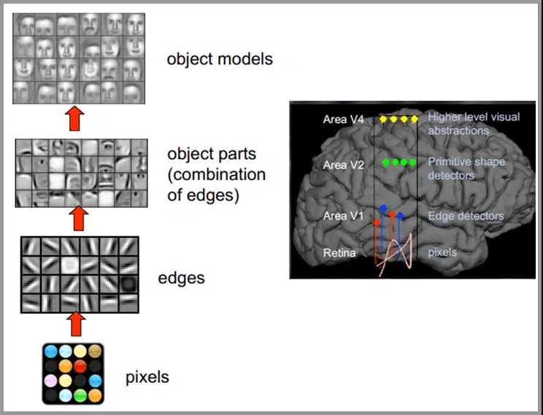
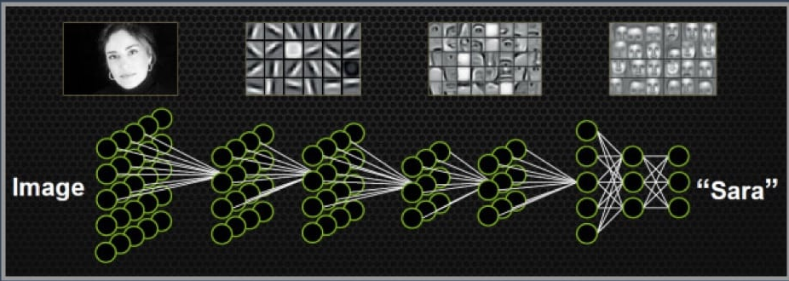
人类的视觉原理如下：从原始信号摄入开始（瞳孔摄入像素 Pixels），接着做初步处理（大脑皮层某些细胞发现边缘和方向），然后抽象（大脑判定，眼前的物体的形状，是圆形的），然后进一步抽象（大脑进一步判定该物体是只气球）。
计算机视觉的原理是什么？
目前主流的基于深度学习的机器视觉方法，其原理跟人类大脑工作的原理比较相似。
人类的视觉原理如下:
-> 从原始信号摄入开始（瞳孔摄入像素 Pixels）
-> 做初步处理（大脑皮层某些细胞发现边缘和方向）
-> 抽象（大脑判定，眼前的物体的形状，是圆形的）
-> 进一步抽象（大脑进一步判定该物体是只气球）
机器的方法也是类似：
-> 构造多层的神经网络
-> 较低层的识别初级的图像特征
-> 若干底层特征组成更上一层特征
-> 最终通过多个层级的组合，在顶层做出分类

Slide 54
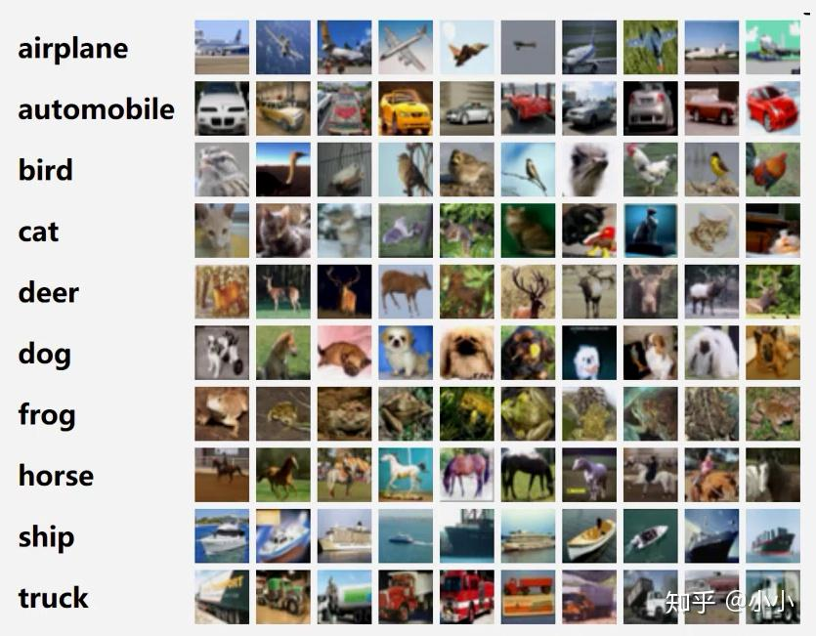
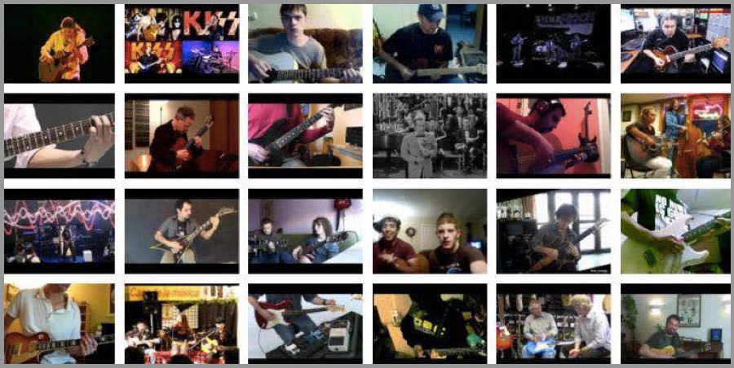






计算机视觉的 8 大任务
图像分类 视频分类 目标检测 目标跟踪
语义分割 实例分割 场景文字识别 人体关键点检测

Slide 55
Experiment & Example Presentation

Slide 56


Face Recogntion
使用开源库face_recogntion + 自训练人脸库 实现人脸匹配和实时人脸识别
使用开源框架deepface + 网上预训练模型库 实现情绪/年龄/性别/人种等判断
face_recogntion
deepface
实验环境：Win11+Python 3.6(切换低版本环境更易装)+face_recogntion1.3+dlib19.8
实验环境：Ubuntu22.04+Python3.10+deepface

Slide 57





face_recogntion
人脸检测：定位与框选
使用方向梯度直方图(HOG)来检测人脸位置。先将图片灰度化，接着计算图像中像素的梯度。通过将图像转变成HOG形式，就可以获得人脸位置。

Slide 58




face_recogntion
人脸对齐将不同角度的人脸图像对齐成同一种标准的形状。
先定位人脸上的特征点，然后通过几何变换（仿射、旋转、缩放），使各个特征点对齐（将眼睛、嘴等部位移到相同位置）。
特征点识别：人脸对齐

Slide 59





face_recogntion
人脸图像的像素值会被转换成紧凑且可判别的特征向量，这也被称为模板（template）。理想情况下，同一个主体的所有人脸都应该映射到相似的特征向量。
在人脸匹配构建模块中，两个模板会进行比较，从而得到一个相似度分数，该分数给出了两者属于同一个主体的可能性。
人脸匹配:人脸对齐和人脸编码
!=
=

Slide 60

face_recogntion
实时人脸检测
前期数据库准备
在db文件夹中为每个人创建一个数据集，并在db下存放姓名索引
照片分辨率调节/图像增强
由于照片尺寸不同，过大不利于处理，标准化分辨率。
由于数据集较少，因此对图片进行变暗/加亮/高斯模糊处理以扩大数据集
获取特征向量
使用face_recognition对每张人脸进行编码，把每个人的特征向量存储下来，当做比对数据库，最终形成一个facedata.pkl文件
调用摄像头
图片增强
特征提取
数据库存储的是每个人每张图片的128维向量，使用摄像头捕捉到人脸之后，使用捕捉的人脸也得到一个128的向量，把这向量和数据库中的向量进行比对，找出距离的均值最短的就是这个人的标签，如果比对完所有的数据发现距离距离最短的人的也很大，那说明这个摄像头捕捉到的人没有在数据库中。
标准化尺寸
调用摄像头实时识别

Slide 61




face_recogntion
实时人脸检测，展示
结果可见，排除光线等客观因素，虽然训练数据集较少，但是对于数据集中人脸识别率较高，误识别概率极低。
但是对于不同年龄，面容遮挡仍有些不足。

Slide 62

deepface
Deepface 是一个用于 python 的轻量级人脸识别和人脸属性分析（年龄、性别、情感和种族）框架。它是一个混合人脸识别框架。
deepface包含最先进的模型：VGG-Face、Google FaceNet、OpenFace、Facebook DeepFace和DeepIDArcFaceDlib。所有这些模型都封装在一起，Deepface 的人脸识别准确率高达 97%，并且已被证明在人脸检测方面比一般的人脸识别框架更成功。Facebook 使用 Deepface 来防止其平台上的假冒和身份盗用。
本人使用网络开源训练的Age/Gender/Race/Emotion数据模型进行实验
年龄
准确度
人种
性别
表情

Slide 63

deepface
人脸验证，通过VGG-Face模型，计算两个照片特征向量之间的余弦相似度（Cosine Similarity）来度量是否为同一人，对于不同的场景，我们可以调整不同的阈值

Slide 64



deepface
使用VGG-Face模型，和扩展的Age/Gender/Emotion模块对采集到的帧进行人脸分析，推测各个信息。
在实际实验过程中发现，预训练模型可能多基于欧美人脸数据集，对于亚洲人的面貌识别仍存在较大不足，特别是年龄和表情，存在较大误差。
可视化，实时监测
开心
脸
惊讶
脸

Slide 65
Thanks

